Slide 1
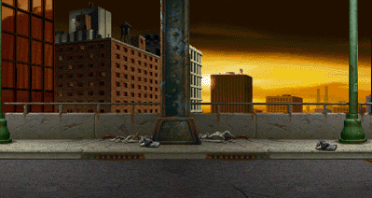
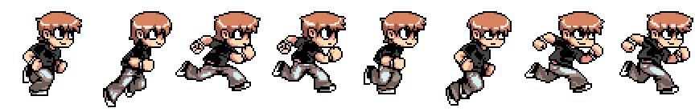
TINY QUEST
Cameron Balkaran,Nusratullah Barak
“Four Dollar Ideas”

Slide 2
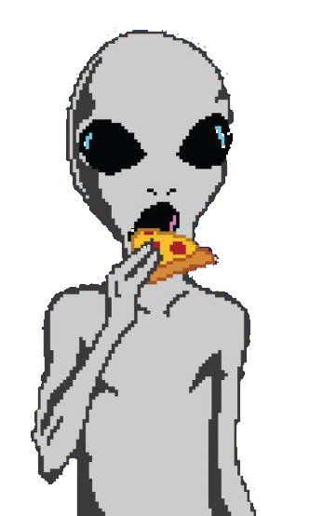

TINY QUEST
Cameron Balkaran,Nustrallah Barak
“Four Dollar Ideas”
Save the world from aliens!
(Classic I know)

Slide 3
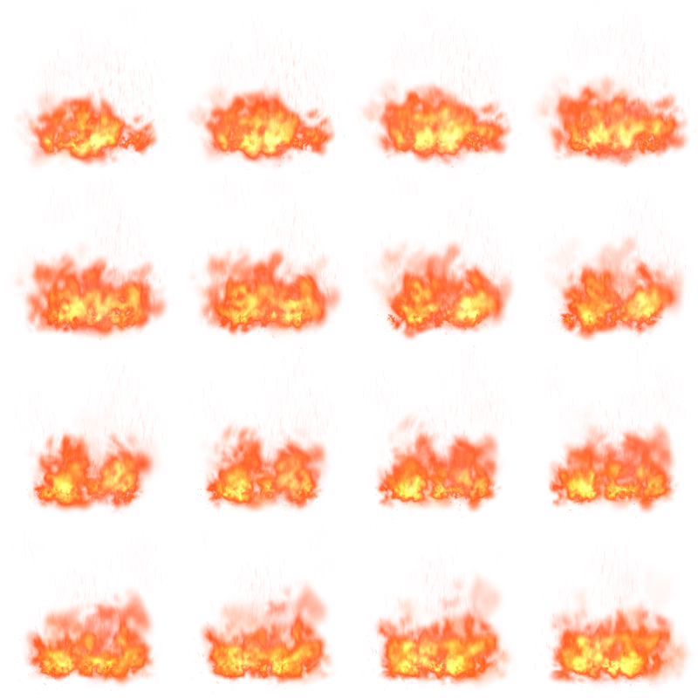

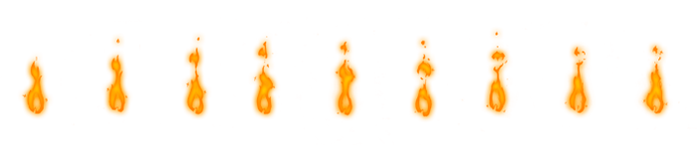
TINY QUEST
Cameron Balkaran,Nustrallah Barak
“Four Dollar Ideas”
Arrow Left:Move Left
Arrow Right:Move Right
Space :Shoot

Slide 4
TINY QUEST
Cameron Balkaran,Nustrallah Barak
“Four Dollar Ideas”
Score +1
If alien killed
Challenge: Kill Aliens
Avoid: Contact From Aliens
Health - 1
If touched by alien
(You have a max of 100 HP)

Slide 5
TINY QUEST
Cameron Balkaran,Nustrallah Barak
“Four Dollar Ideas”
Winner
Score: 1000

